Slide 1
ABC Call Volume Trend Analysis
Project no. 8 :- USING EXCEL STATISTICS

Slide 2
PROJECT DESCRIPTION
A customer experience (CX) team is made up of experts who examine data and consumer input before sharing their findings with the rest of the company. The roles and responsibilities that these teams typically carry out include: Customer experience programs (CX programs), Digital customer experience, Design and processes, Internal communications, Voice of the customer ( VOC ), User experiences, Customer experience management, Journey mapping, Nurturing customer interactions, Customer success, Customer support, Handling Customer Data, and Learning about the Customer Journey.
Customer service representatives, often known as call centre agents or customer service agents, have several job options within a customer experience team. They can play a variety of responsibilities, such as email support, social media support, inbound support, and outbound support. The call centre tasked with answering consumer incoming calls is referred to as inbound customer support. Inbound calls are incoming voice calls from clients or potential clients of your company that are handled by customer service agents. The approach of appealing, enticing, and satisfying your customers to make them steadfast supporters of your company is known as inbound customer service. You may thrill your clients and transform them into a development engine for your organization by resolving their difficulties and assisting them in succeeding with your product or service.

Slide 3
OBJECTIVES
Average Call Duration Analysis: Calculate the average duration of incoming calls for each time bucket to understand peak calling periods and agent workload distribution.
Call Volume Visualization: Create a graphical representation showing the total number of calls received in each time bucket to identify patterns and trends in call volume throughout the day.
Manpower Allocation Proposal: Develop a plan for allocating manpower during each time bucket to reduce the abandon rate from 30% to 10%, ensuring a high level of customer service and satisfaction.
Night Shift Manpower Planning: Propose a strategy for staffing night shifts to handle the additional 30 calls received between 9 pm and 9 am, maintaining a maximum abandon rate of 10% and enhancing overall customer experience.
Assumptions Alignment: Ensure that the proposed plans align with key assumptions regarding agent working hours, leave allowances, and call handling capacity to optimize resource utilization and meet customer service targets.

Slide 4
APPROACH & TECH STACK & TASKS
The project will begin by thoroughly examining the dataset containing information on inbound calls received by ABC Insurance Company. This analysis will involve extracting key metrics such as call duration, call volume, and abandon rates across different time buckets. Insights gained from this analysis will form the basis for understanding customer behavior and optimizing manpower allocation strategies.
A significant aspect of the project's approach involves devising strategies to optimize manpower allocation to ensure efficient handling of incoming calls while minimizing abandon rates. This will entail analyzing peak call periods, identifying staffing requirements for different time buckets, and proposing adjustments to agent schedules to meet service level targets. Additionally, the project will address the need for night shift manpower planning to provide round-the-clock customer support and enhance overall customer experience.
Perform Exploratory Data Analysis (EDA) on the cleaned dataset.
TECH-STACK USED: MS EXCEL , VISUALIAZATION.
TASKS :- CUSTOMER EXPERIENCE ANALYSIS.

Slide 5
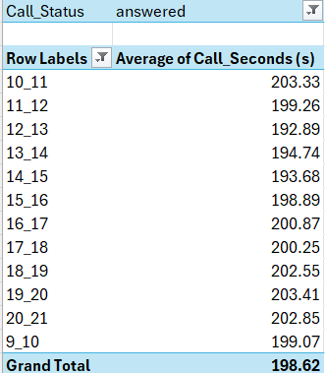
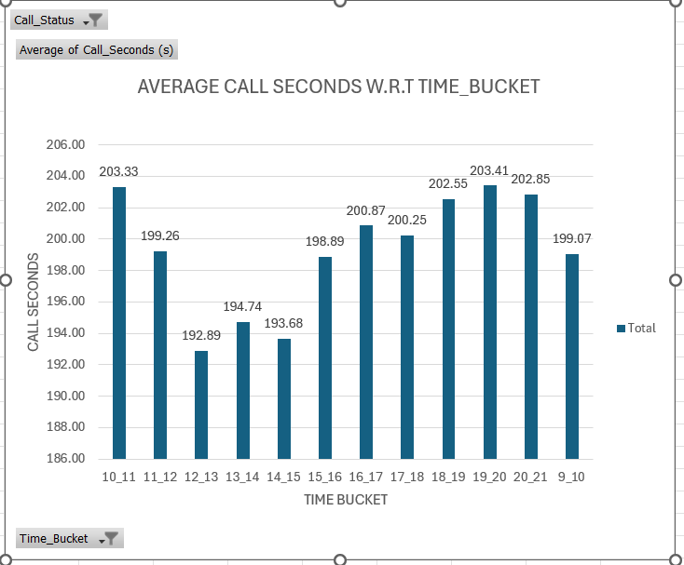
DATA ANALYTICS TASK 1
Average Call Duration: Determine the average duration of all incoming calls received by agents. This should be calculated for each time bucket.
Your Task: What is the average duration of calls for each time bucket?
INSIGHT: 19_20 time bucket handles most of the average calls whereas 12_13 time bucket handles the lowest.

Slide 6
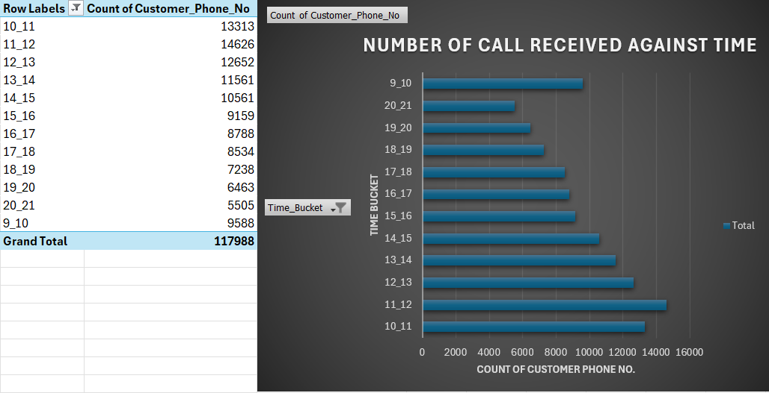
DATA ANALYTICS TASK 2
Call Volume Analysis: Visualize the total number of calls received. This should be represented as a graph or chart showing the number of calls against time. Time should be represented in buckets (e.g., 1-2, 2-3, etc.).
Your Task: Can you create a chart or graph that shows the number of calls received in each time bucket?
INSIGHT: From the CHART it can be concluded that 11_12 time bucket experienced the highest call volume of 14626 as compared to others.

Slide 7
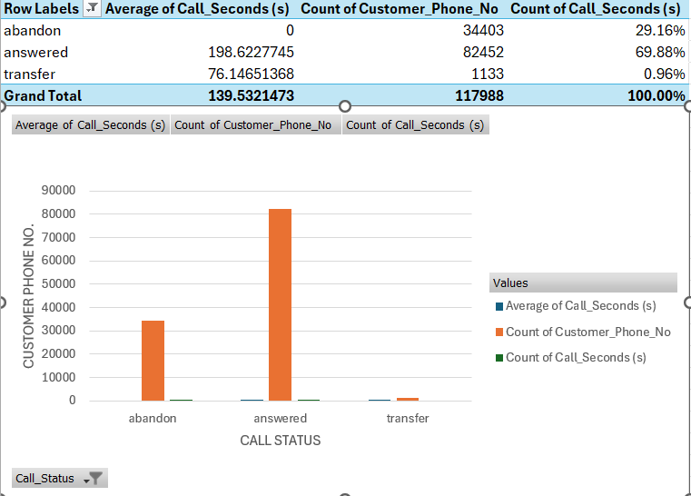
DATA ANALYTICS TASK 3A
Manpower Planning: The current rate of abandoned calls is approximately 30%. Propose a plan for manpower allocation during each time bucket (from 9 am to 9 pm) to reduce the abandon rate to 10%. In other words, you need to calculate the minimum number of agents required in each time bucket to ensure that at least 90 out of 100 calls are answered.
Your Task: What is the minimum number of agents required in each time bucket to reduce the abandon rate to 10%?

Slide 8
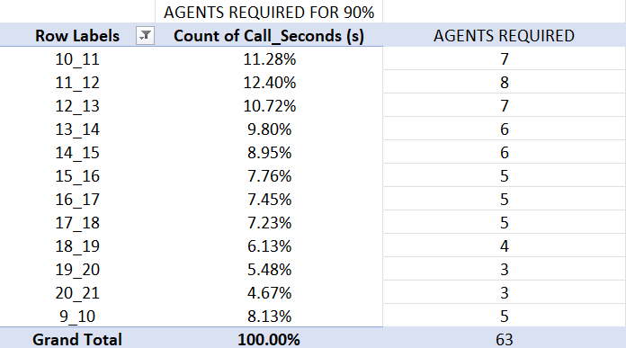
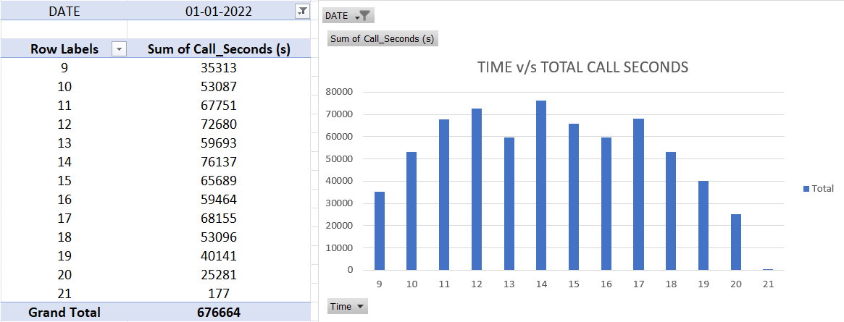
DATA ANALYTICS TASK 3B

Slide 9
DATA ANALYTICS TASK 4
Night Shift Manpower Planning: Customers also call ABC Insurance Company at night but don't get an answer because there are no agents available. This creates a poor customer experience. Assume that for every 100 calls that customers make between 9 am and 9 pm, they also make 30 calls at night between 9 pm and 9 am. The distribution of these 30 calls is as follows
Your Task: Propose a manpower plan for each time bucket throughout the day, keeping the maximum abandon rate at 10%.
Assumptions: An agent works for 6 days a week; On average, each agent takes 4 unplanned leaves per month; An agent's total working hours are 9 hours, out of which 1.5 hours are spent on lunch and snacks in the office. On average, an agent spends 60% of their total actual working hours (i.e., 60% of 7.5 hours) on calls with customers/users. The total number of days in a month is 30.

Slide 10
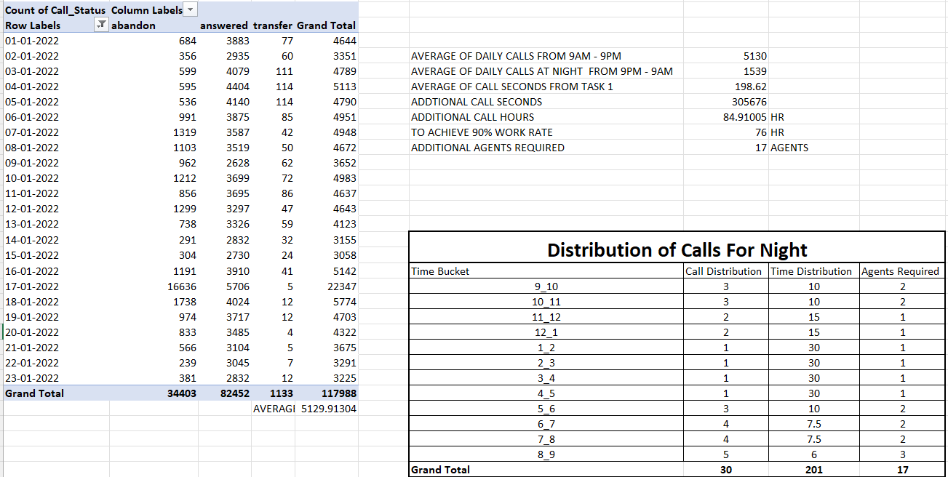
DATA ANALYTICS TASK 4

Slide 11
INSIGHTS
Analysts are integral to enhancing customer satisfaction by identifying patterns in data and proposing actionable improvements to customer service operations, fostering steadfast loyalty among clients.
AI-driven solutions like Interactive Voice Response (IVR) systems effectively address consumer inquiries by recognizing specific issues and routing calls to appropriate agents, resulting in reduced wait times and individualized support, thus ensuring a smooth client experience.
Standardizing data formats, such as pre-calculated time buckets and call durations converted into seconds, enhances productivity and accuracy in data analysis, allowing analysts to focus on evaluation rather than manual conversions, thereby streamlining processes.
Behavioral analytics offers valuable insights into consumer behavior, enabling businesses to identify trends, preferences, and opportunities for enhancing the customer experience through tailored products and services, ultimately fostering deeper and more meaningful relationships with consumers.
This project serves as a valuable learning experience, equipping analysts with essential knowledge and skills to maximize client satisfaction, pinpoint areas for development, and implement practical plans to improve the overall customer experience, thereby supporting organizational growth and development.

Slide 12
CONCLUSION
Strategic Shift Scheduling: By analyzing call patterns and implementing staggered shift schedules, the business can optimize employee allocation, ensuring continuous coverage during peak and off-peak hours, thereby enhancing operational efficiency and customer service.
Outlier Awareness and Practical Planning: Recognizing the presence of outliers in data analysis is crucial for drawing accurate conclusions. Implementing practical plans based on insights derived from data analysis helps optimize personnel allocation, improve efficiency, and enhance customer service quality, ultimately leading to enhanced operational performance and customer satisfaction
GOOGLE DRIVE – PRESENTATION FILES – LINK
VIDEO LINK – VIDEO MIGHT BE BIG , PLEASE SIR/MADAM DOWNLOAD TO VIEW THE EXPLAINATION.
GOOGLE DRIVE – ANALYSIS FILE – LINK
EXCEL LINK

Slide 13
THANK YOU.

